Slide 1
Segment 2
Segment 1
4
4
Segment 4
100
100
C: 400
A: 600
2
1
D: 300
100
2
Segment 3
Segment 5
4
4
B: 500
19
2
Root Bridge
E: 100
F: 200
19
4
19
Segment 6

Slide 2
Segment 2
Segment 1
4
4
Segment 4
100
100
C: 400
A: 600
2
1
D: 300
100
Root Port
2
Segment 3
Segment 5
4
4
B: 500
19
2
Root Bridge
E: 100
F: 200
19
4
19
Segment 6

Slide 3
Segment 2
Segment 1
4
4
Segment 4
100
100
C: 400
A: 600
DB for Segment 2 and 4
2
1
D: 300
100
Root Port
2
Segment 3
Segment 5
4
4
B: 500
19
2
Root Bridge
DB for Segment 1
E: 100
F: 200
19
DB for Segment 3, 5 and 6
4
19
Designated Bridge (DB)
Segment 6

Slide 4
Segment 2
Segment 1
4
4
Segment 4
100
100
C: 400
A: 600
2
DB 2, 4
1
D: 300
100
DP for segment 2
DP for segment 4
Root Port
2
Segment 3
Segment 5
4
4
DP for segment 5
B: 500
19
2
DP for segment 1
Root Bridge
DB 1
DP for segment 3
E: 100
DB 3, 5, 6
F: 200
19
DP for segment 6
4
19
Designated Bridge (DB)
Designated Port (DP)
Segment 6

Slide 5
Segment 2
Segment 1
4
4
Segment 4
100
100
C: 400
A: 600
2
DB 2, 4
1
D: 300
100
DP for segment 2
DP for segment 4
Root Port
2
Segment 3
Segment 5
4
4
DP for segment 5
B: 500
19
2
DP for segment 1
Root Bridge
DB 1
DP for segment 3
E: 100
DB 3, 5, 6
F: 200
19
DP for segment 6
4
Disabled Port
19
Designated Bridge (DB)
Designated Port (DP)
Segment 6

Slide 6
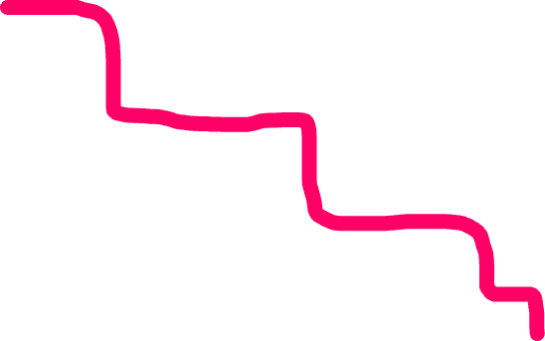
Segment 1 to Segment 6
Segment 2
Segment 1
4
4
Segment 4
100
100
C: 400
A: 600
2
DB 2, 4
1
D: 300
100
DP for segment 2
DP for segment 4
Root Port
2
Segment 3
Segment 5
4
4
DP for segment 5
B: 500
19
2
DP for segment 1
Root Bridge
DB 1
DP for segment 3
E: 100
DB 3, 5, 6
F: 200
19
DP for segment 6
4
Disabled Port
19
Designated Bridge (DB)
Designated Port (DP)
Segment 6

Slide 7

Segment 1 to Segment 2
Segment 2
Segment 1
4
4
Segment 4
100
100
C: 400
A: 600
2
DB 2, 4
1
D: 300
100
DP for segment 2
DP for segment 4
Root Port
2
Segment 3
Segment 5
4
4
DP for segment 5
B: 500
19
2
DP for segment 1
Root Bridge
DB 1
DP for segment 3
E: 100
DB 3, 5, 6
F: 200
19
DP for segment 6
4
Disabled Port
19
Designated Bridge (DB)
Designated Port (DP)
Segment 6

Slide 8
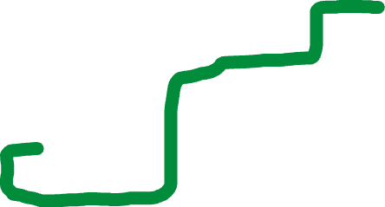
Segment 4 to Segment 3
Segment 2
Segment 1
4
4
Segment 4
100
100
C: 400
A: 600
2
DB 2, 4
1
D: 300
100
DP for segment 2
DP for segment 4
Root Port
2
Segment 3
Segment 5
4
4
DP for segment 5
B: 500
19
2
DP for segment 1
Root Bridge
DB 1
DP for segment 3
E: 100
DB 3, 5, 6
F: 200
19
DP for segment 6
4
Disabled Port
19
Designated Bridge (DB)
Designated Port (DP)
Segment 6

